Slide 1
Predicting Diabetes Using Machine Learning
DATA 606 - CAPSTONE PROJECT Project By : Shankara Parameshwari Navya Sri Dameruppula

Slide 2
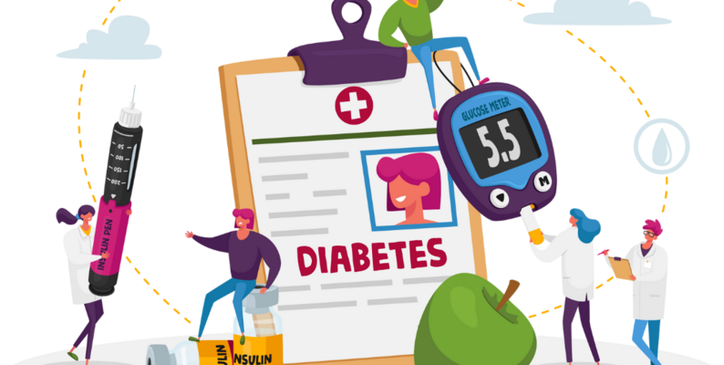
CONTENTS OF THE PRESENTATION
INTRODUCTION
EDA & PREPROCESSING
MODELLING & EVALUATION
WEB APPLICATION

Slide 3
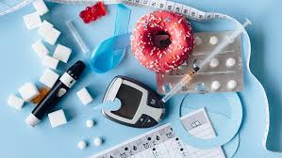
Introduction:
Diabetes is a prevalent chronic condition affecting millions worldwide, characterized by abnormal insulin production or utilization.
Early detection and management are crucial for preventing complications and improving quality of life.
Machine learning offers a promising approach to predict diabetes risk based on patient data, aiding in early intervention and personalized care.

Slide 4
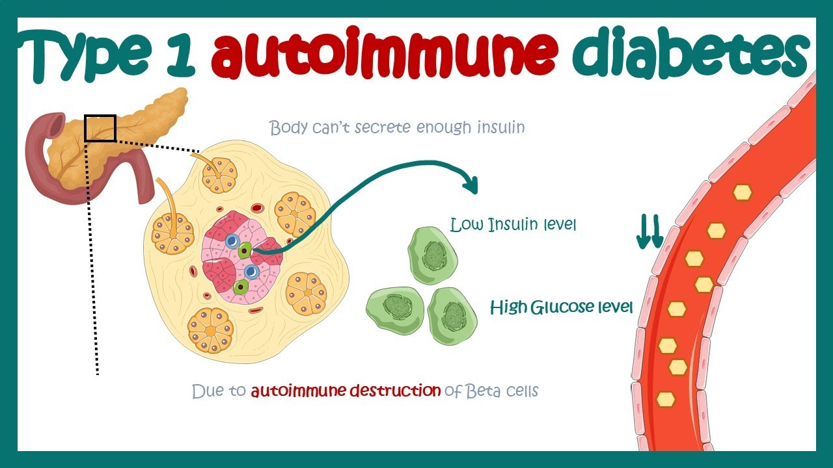
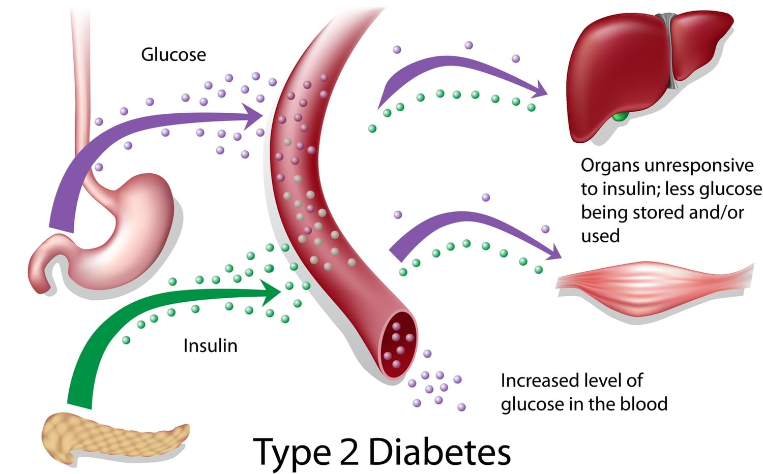
Understanding Diabetes
Type 1: Autoimmune destruction of insulin-producing cells
Type 2: Insulin resistance and impaired insulin secretion.
Causes & Risk Factors: Genetic predisposition and environmental triggers.
Causes & Risk Factors: Obesity, sedentary lifestyle, genetics, age.

Slide 5
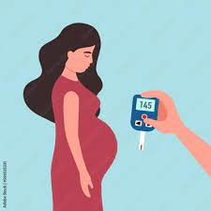
Type 3: Gestational: High blood sugar during pregnancy.
Causes & Risk Factors: Hormonal changes, pre-pregnancy obesity.

Slide 6
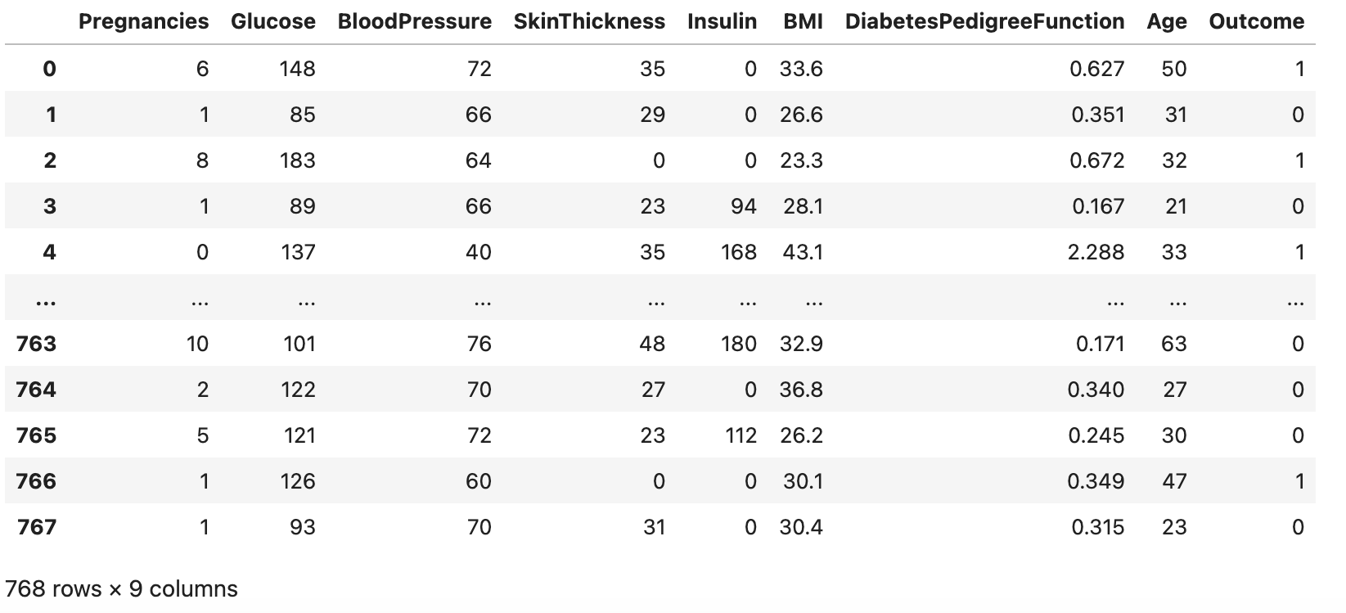
About the Data

Slide 7
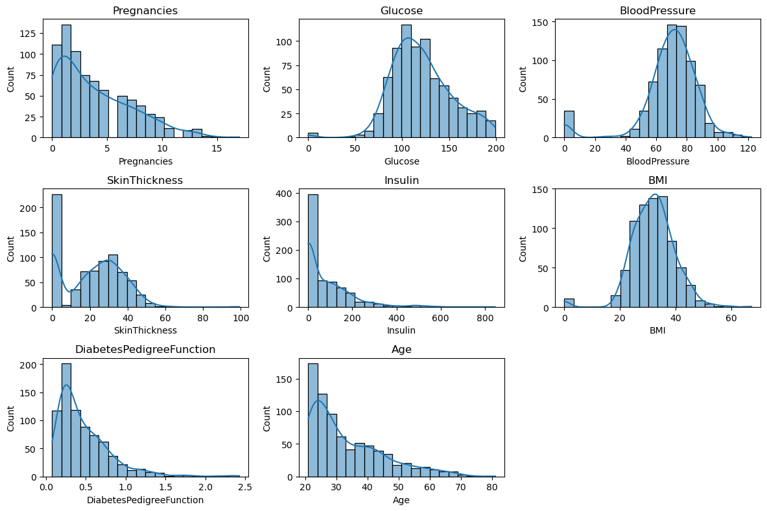
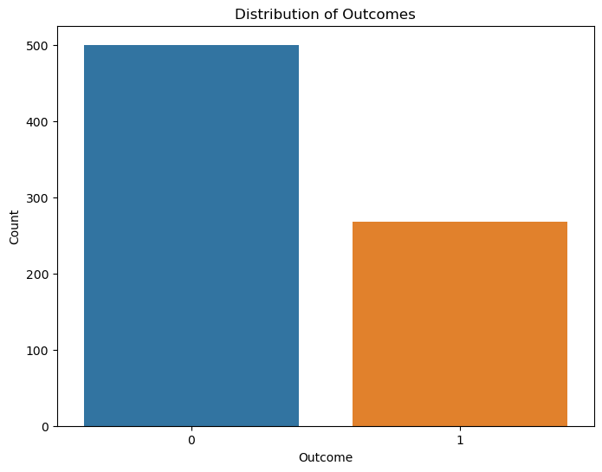
Distribution of Numerical Features.
Count plot
Target variable:
0: No diabetes (500 Members)
1: Diabetes ( 268 Members )

Slide 8
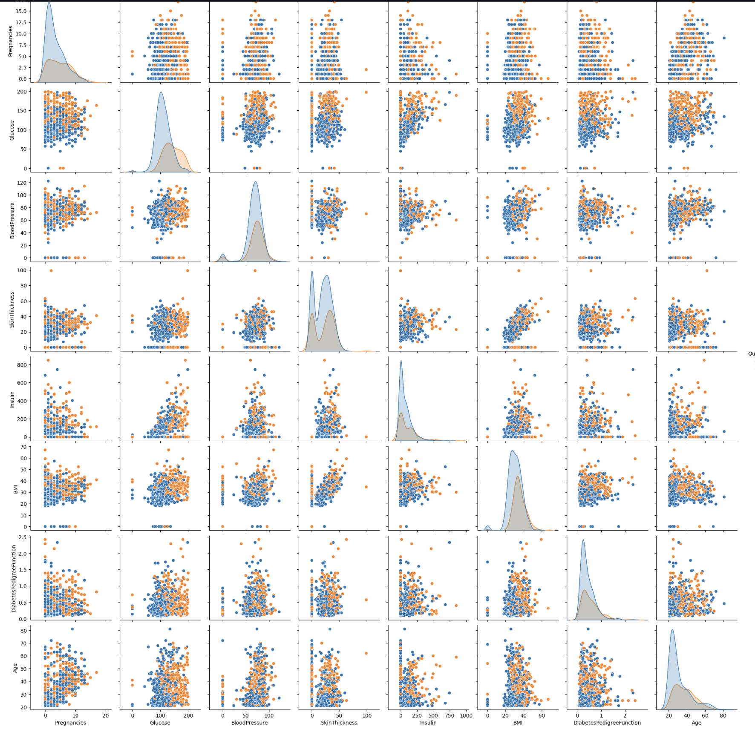
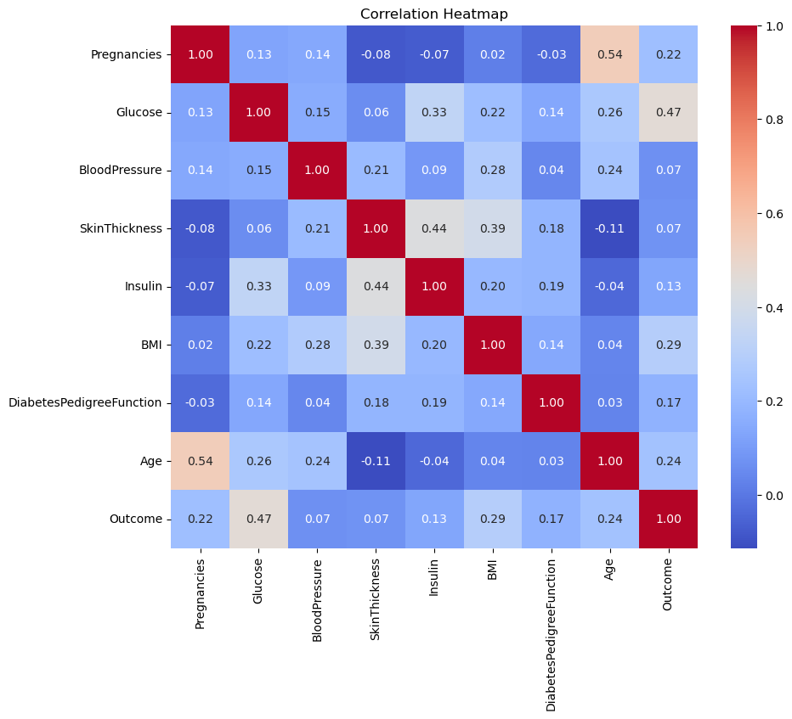
Pairplot with Outcome Comparison
Heat Map
Heatmap: {Feature Selection}
Pregnancies and Age have a 0.54 relation.
Glucose plays a Vital role which has 0.47 on outcome value.
BMI and Insulin with ~ 0.40.

Slide 9
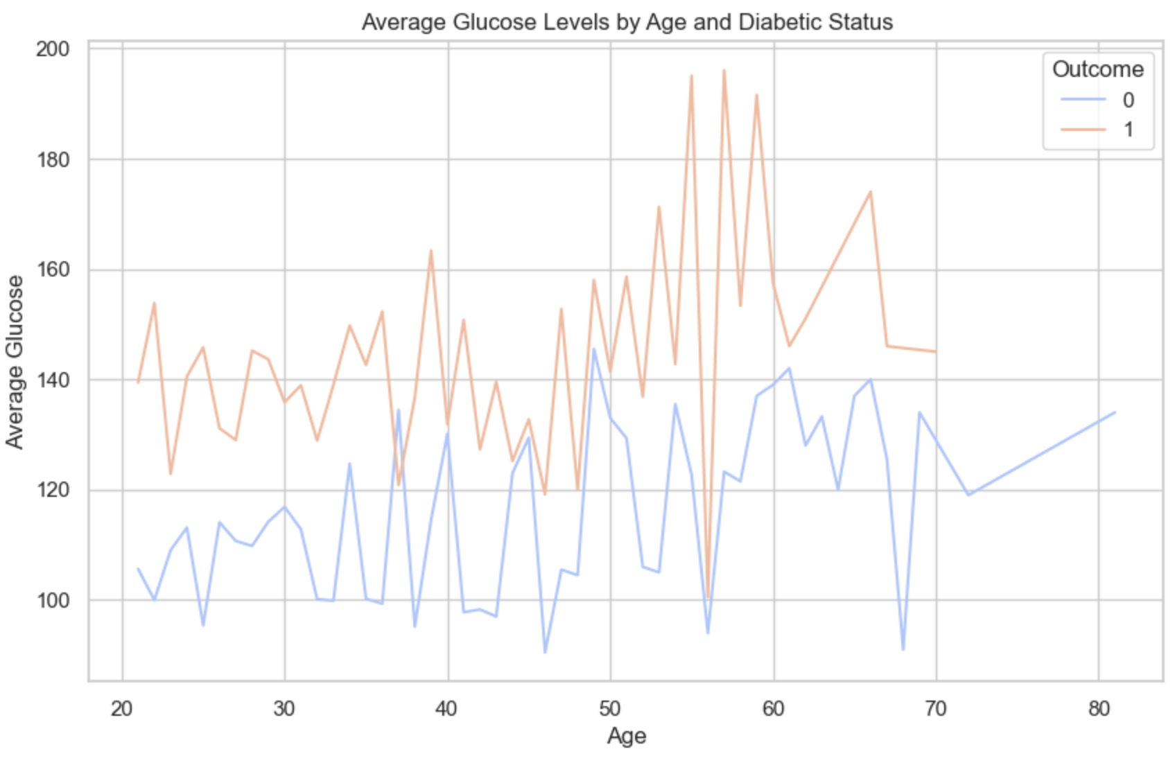
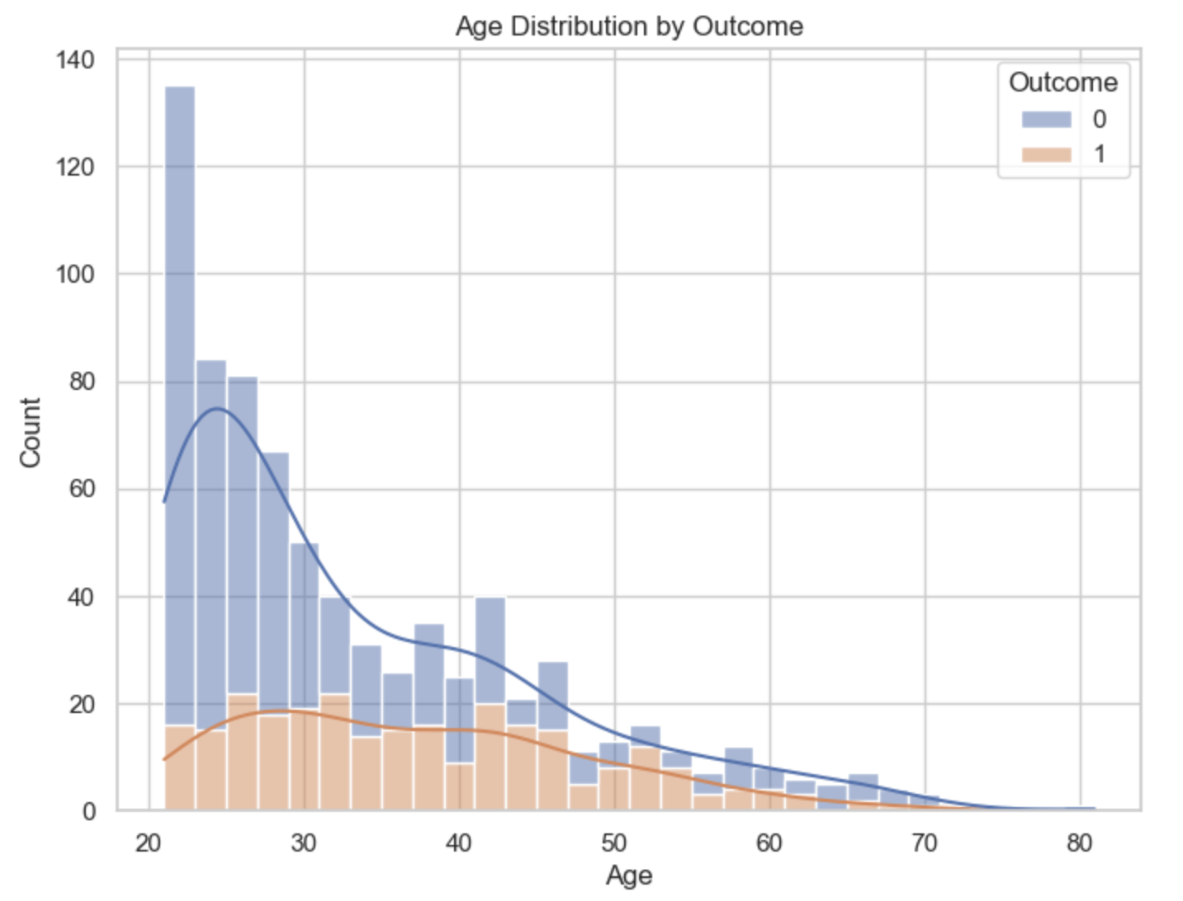
Age vs. Glucose
Age Distribution by Outcome.

Slide 10
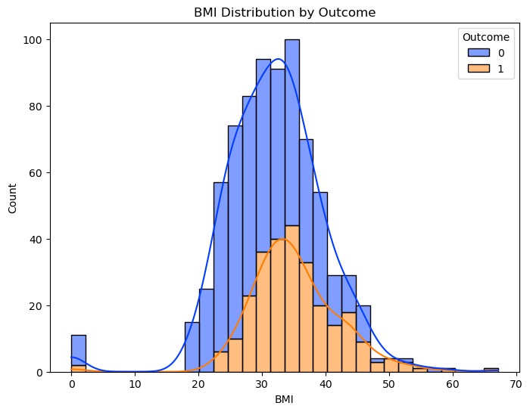
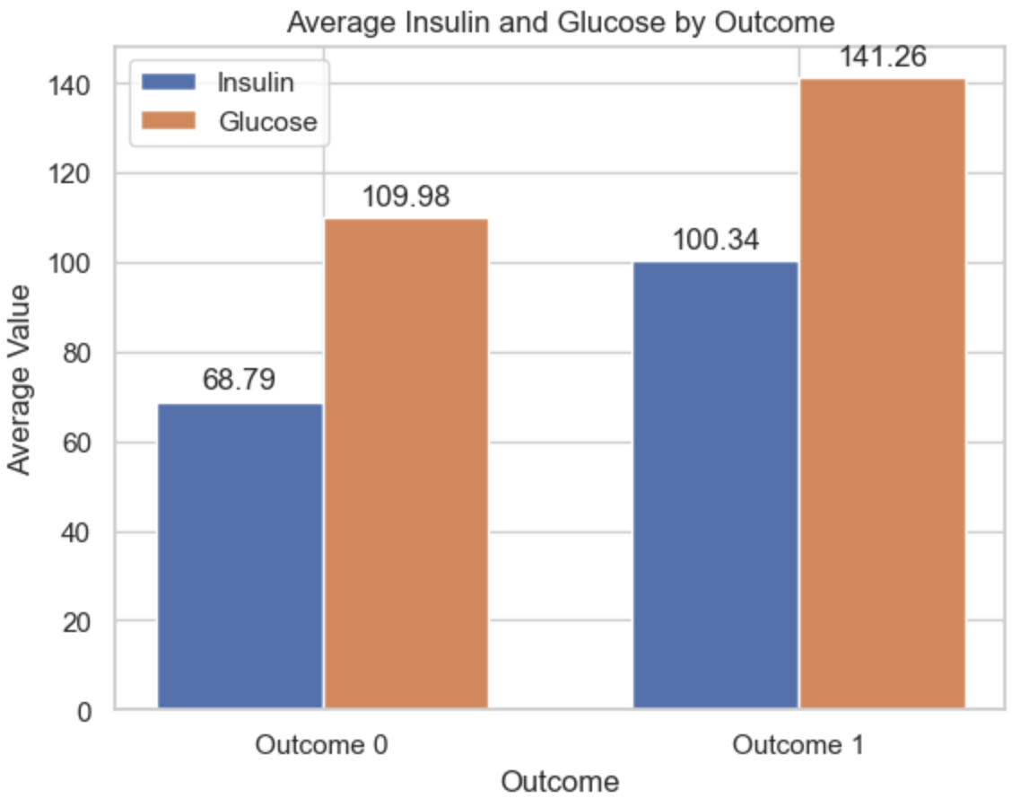
BMI Distribution by Diabetes Outcome.
Insulin vs. Glucose.

Slide 11
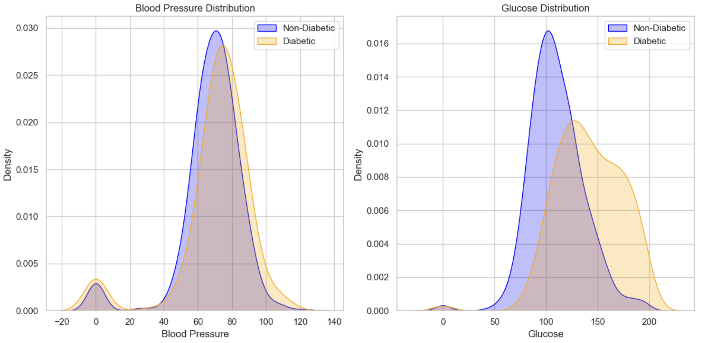
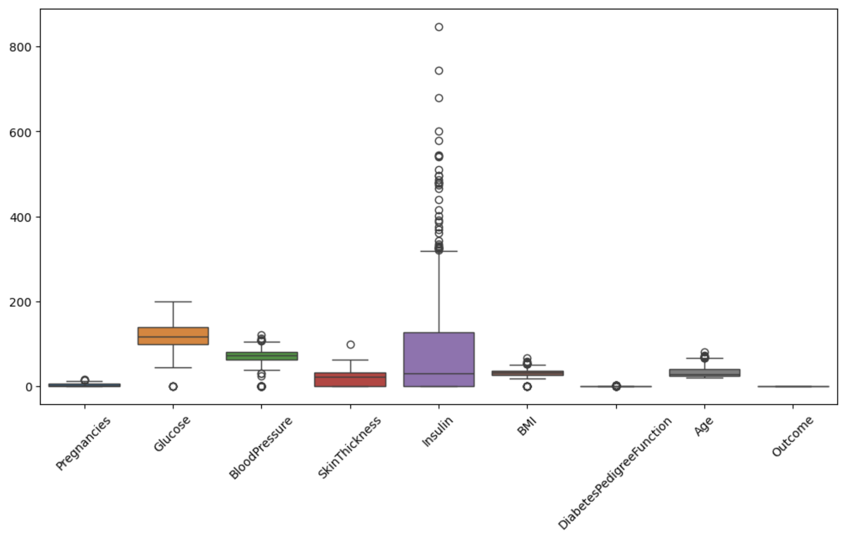
Blood Pressure vs. Glucose.
Boxplot

Slide 12
Modeling
Data Preparation
Model Training and Tuning
Model Evaluation

Slide 13
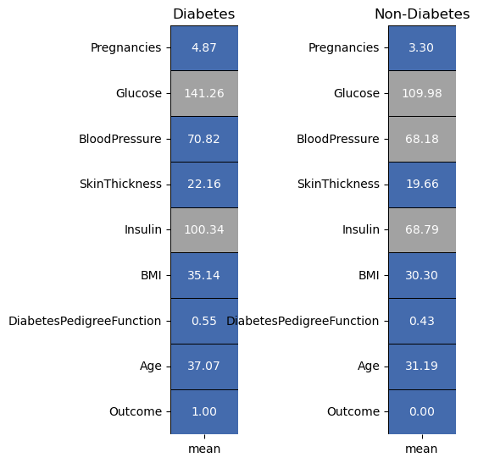
Comparison of Mean Feature Values between Diabetic and Non-Diabetic Individuals

Slide 14
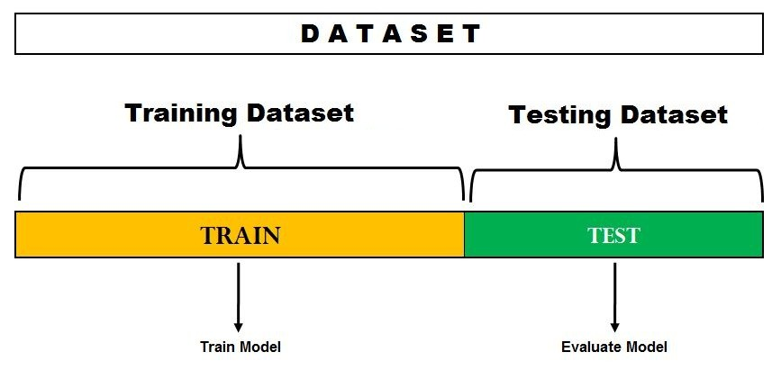
Data Preprocessing
Data Splitting:
Utilized train_test_split function to split data into training and testing sets (80/20 ratio).
X = features (excluding Outcome), y = target variable (Outcome).
Feature Scaling:
StandardScaler applied to standardize feature values, ensuring uniform scale across variables.
X_train_scaled and X_test_scaled obtained for training and testing data respectively.

Slide 15
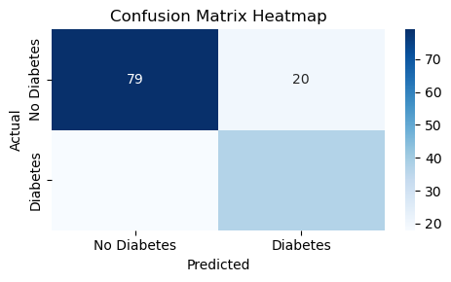
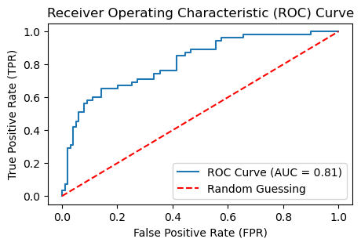
Logistic Regression
Logistic regression is a widely-used classification algorithm suitable for binary outcomes.
Hyperparameters:
Regularization parameter (C), solver algorithm, and maximum iterations.
Hyperparameter Tuning:
Utilized GridSearchCV to search for optimal hyperparameters.
Best Model Parameters:
C: 10, Solver: 'liblinear', Max Iterations: 100.

Slide 16
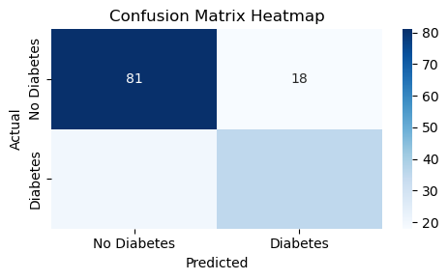
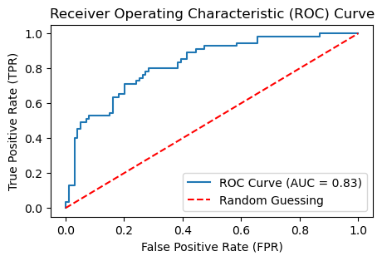
Random Forest Regression
Random Forest Ensemble method combining decision trees, reduces overfitting, improves accuracy through averaging predictions.
Hyperparameters:
Number of estimators, maximum depth, minimum samples split, and minimum samples leaf.
Hyperparameter Tuning:
GridSearchCV utilized to find optimal hyperparameters.
Best Model Parameters:
Number of estimators: 200, Max depth: 20, Min samples split: 5, Min samples leaf: 4.

Slide 17
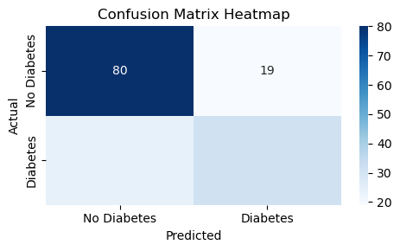
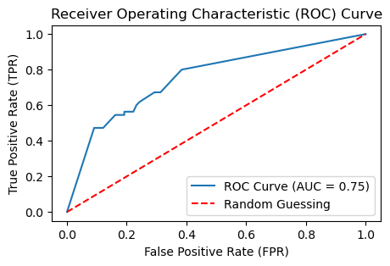
Decision Tree
Decision Tree Classifier constructs a tree-like structure to model decisions based on feature inputs.
Hyperparameters:
Split criterion, maximum depth, minimum samples split, and minimum samples leaf.
Hyperparameter Tuning:
GridSearchCV used to identify optimal hyperparameters.
Search conducted over a range of values for each hyperparameter.
Best Model Parameters:
Criterion: 'gini', Max depth: 10, Min samples split: 2, Min samples leaf: 4.

Slide 18
Logistic Regression
Decision Tree
Gradient Boost
Random Forest
Accuracy: 75%
Recall : 80%
F-1 Score : 81%
Precision : 81%
Accuracy: 76%
Recall : 83%
F-1 Score : 82%
Precision : 80%
Accuracy : 76%
Recall : 83%
F-1 Score : 82%
Precision : 80%
Accuracy : 75%
Recall : 81%
F-1 Score : 81%
Precision : 81%
SVM
K-Nearest Neighbour
Neural Network
Naive Bayes
Accuracy: 73%
Recall : 83%
F-1 Score : 80%
Precision : 77%
Accuracy : 69%
Recall : 80%
F-1 Score : 77%
Precision : 75%
Accuracy: 76%
Recall : 83%
F-1 Score : 82%
Precision : 80%
Accuracy : 77%
Recall : 80%
F-1 Score : 81%
Precision : 83%
Notes:
Table.

Slide 19
Web Application
The web application harnesses Flask, a lightweight and versatile Python web framework, to swiftly construct a user-friendly interface for diabetes risk assessment. Machine learning models, integrated seamlessly via joblib serialization, empower users to predict their likelihood of diabetes based on input data.
Utilizing HTML templates and form handling, the application ensures intuitive data submission and interaction. Flask's session management functionality facilitates data persistence across user sessions, ensuring seamless analysis and result presentation. Validation and error handling mechanisms enhance reliability, providing informative feedback on user inputs. Together, these technologies forge a robust and accessible platform for informed health decision-making.

Slide 20
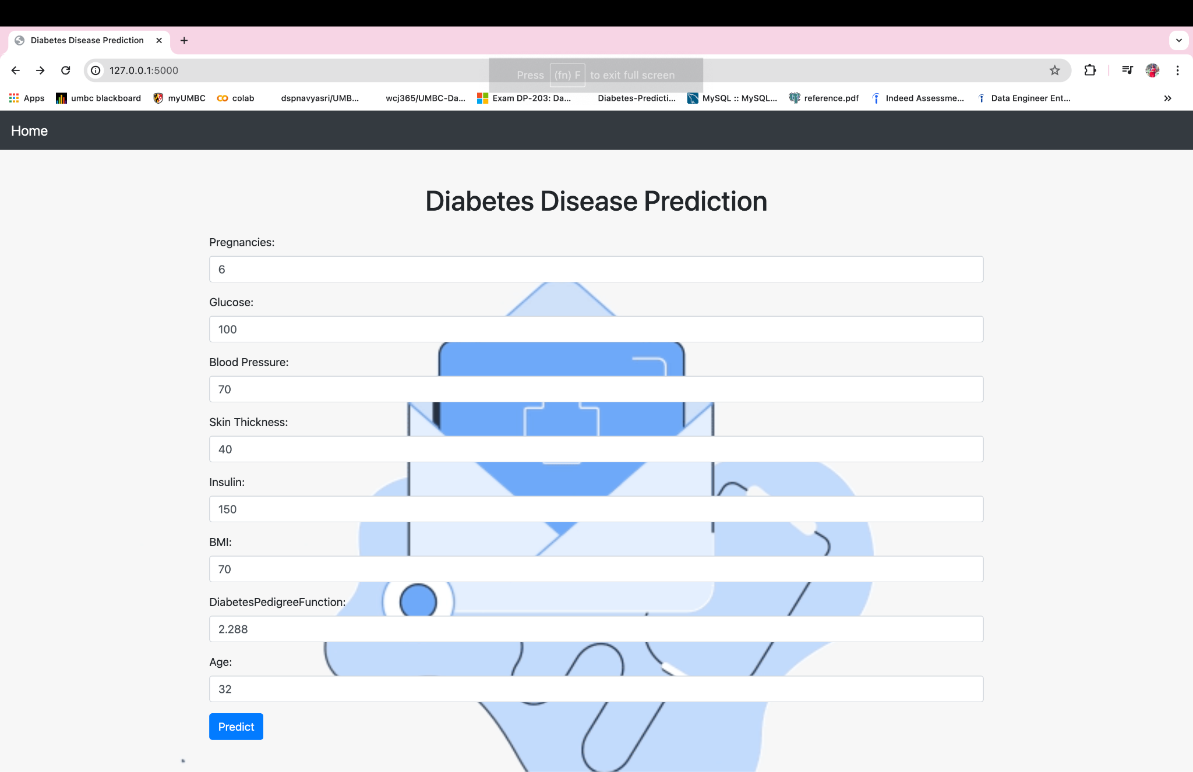

Slide 21
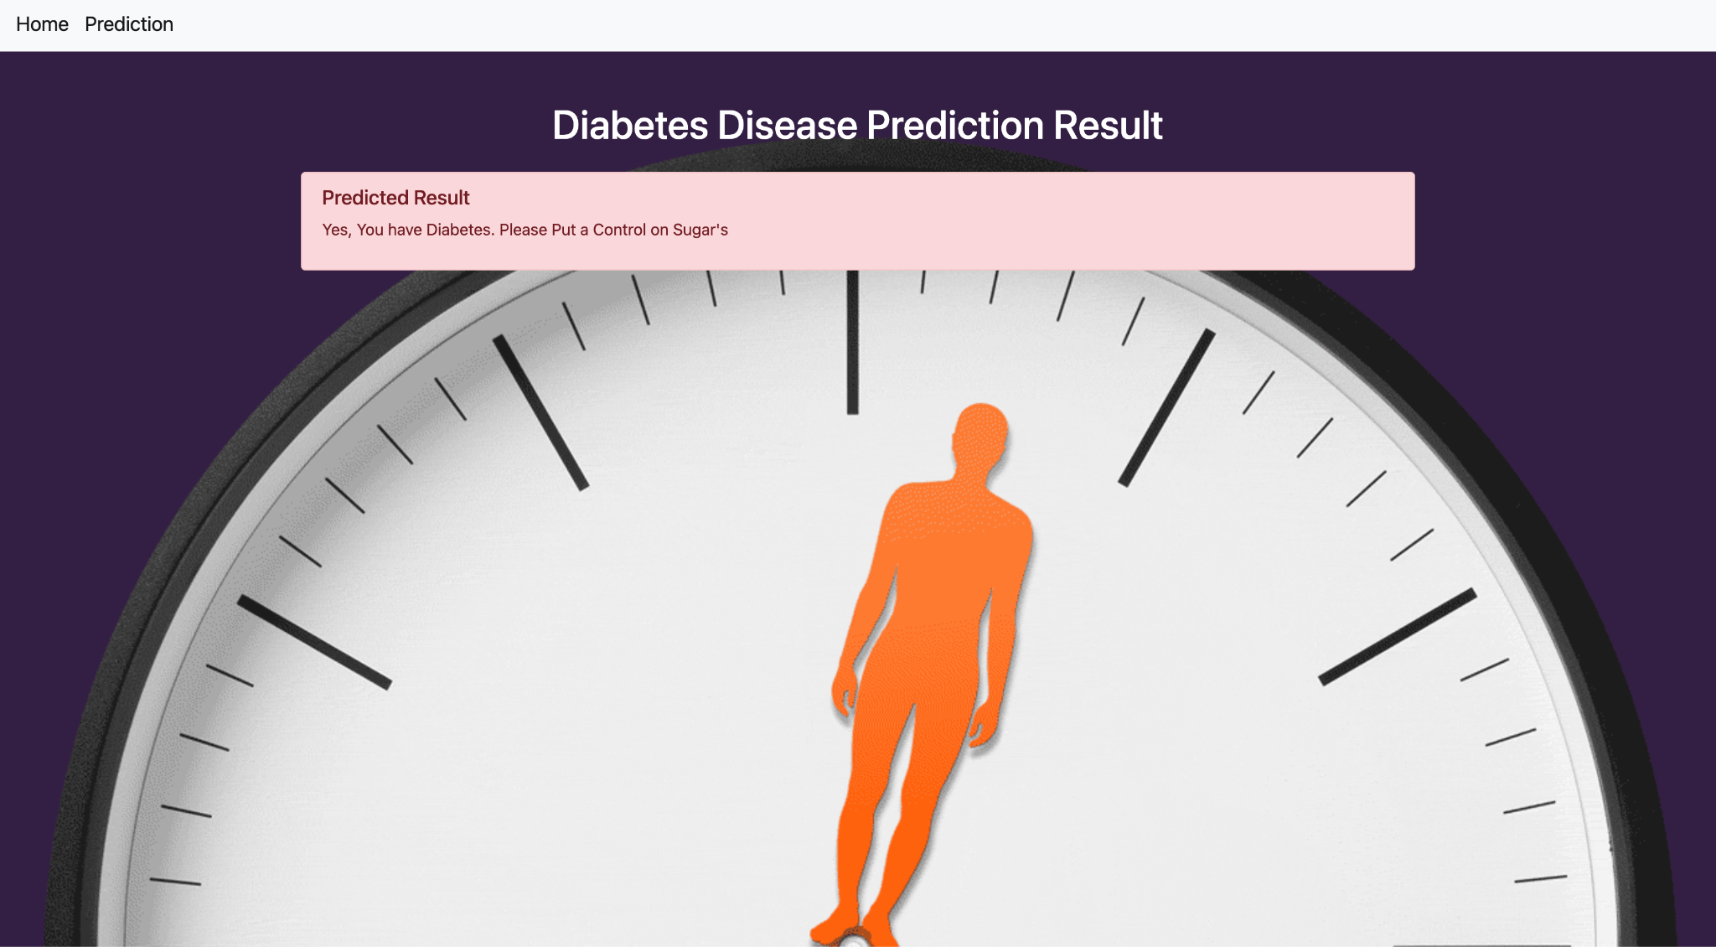

Slide 22
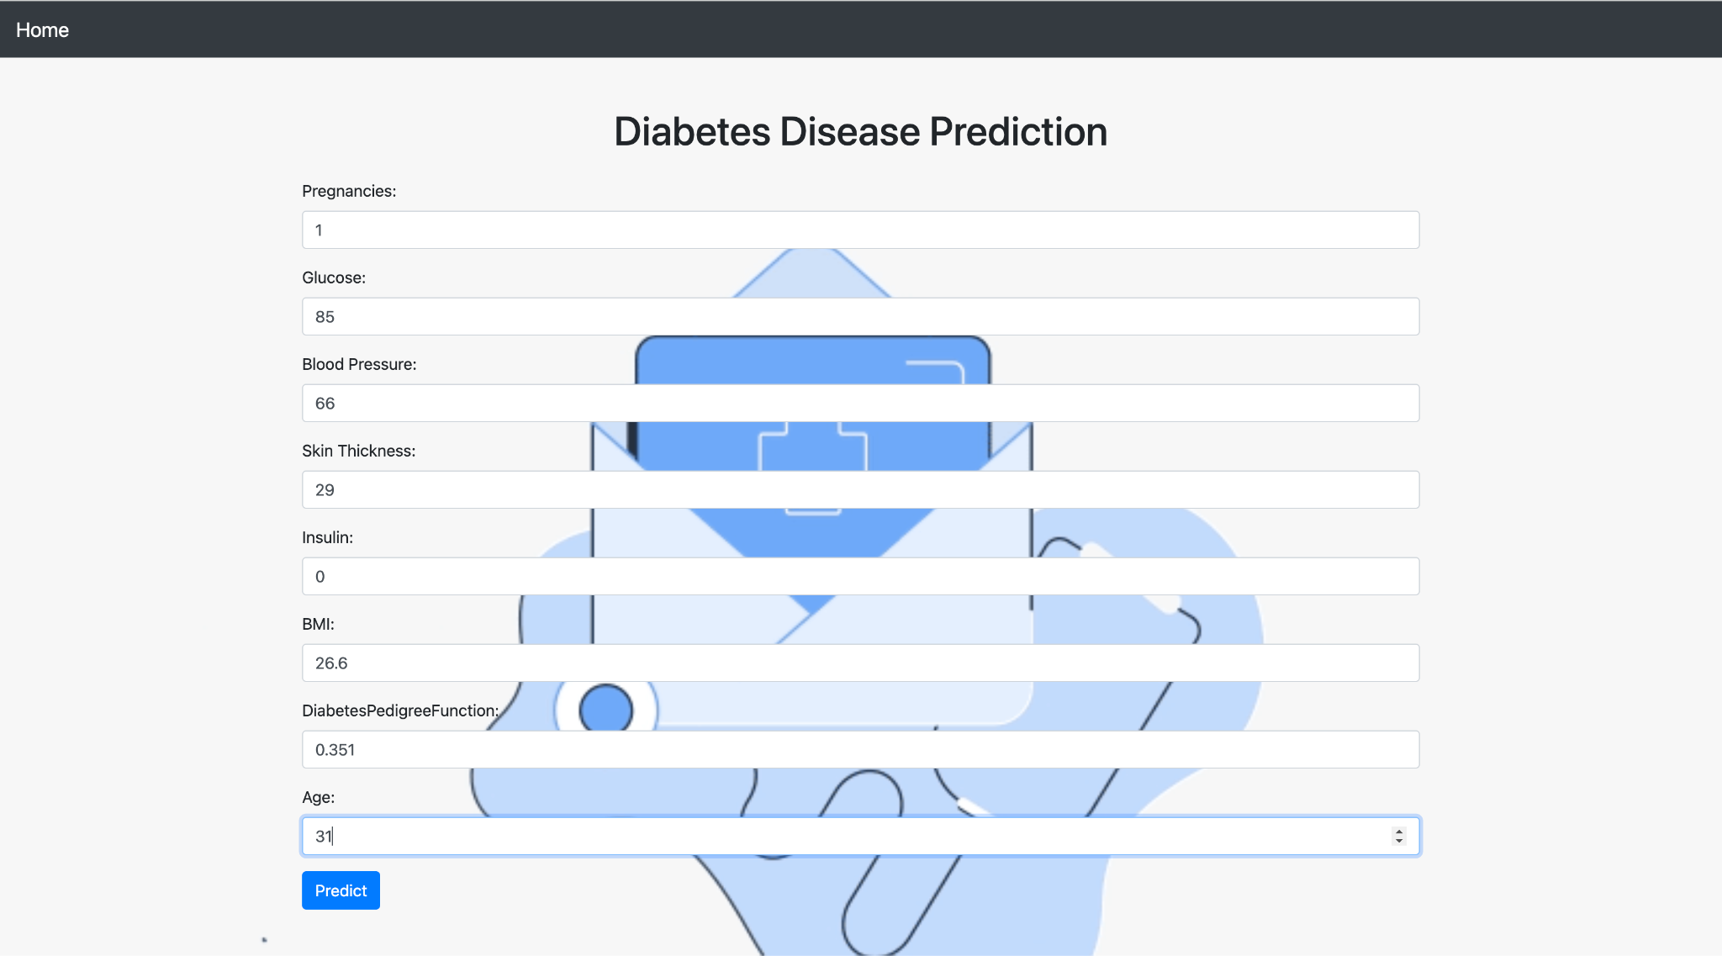

Slide 23
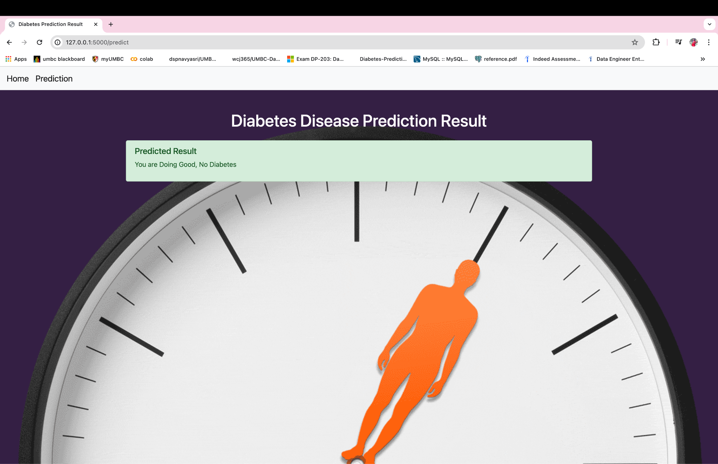

Slide 24
Conclusion
The development of this web application marks a significant step forward in leveraging machine learning for healthcare decision-making. By integrating advanced predictive models with a user-friendly interface, we've created a valuable tool for assessing diabetes risk. Users can now input their health data and receive personalized risk assessments, empowering them to take proactive measures for their well-being.

Slide 25
Future Scope
In the future, we can make this web app even better by adding new features. For example, we could include features like connecting with wearable devices or electronic health records to get real-time health data. This would give users more detailed insights into their health. We can also keep improving the machine learning algorithms we use to make predictions. By doing this, we can make the predictions even more accurate and reliable. Another idea is to work with doctors and hospitals to use this web app in clinics. This way, it can help doctors assess a person's risk of diabetes and plan personalized treatment. Overall, there are lots of exciting possibilities for making this web app more helpful for people managing their health.

Slide 26
References
Tasin, I., Nabil, T. U., Islam, S., & Khan, R. (2022). Diabetes prediction using machine learning and explainable AI techniques. Healthcare technology letters, 10(1-2), 1–10. https://doi.org/10.1049/htl2.12039.
Fregoso-Aparicio, L., Noguez, J., Montesinos, L. et al. Machine learning and deep learning predictive models for type 2 diabetes: a systematic review. Diabetol Metab Syndr 13, 148 (2021). https://doi.org/10.1186/s13098-021-00767-9.

Slide 27
Thank you

